Slide 1
Complexity Analysis Lecture 3

Slide 2
Algorithm Definition
A finite set of statements that guarantees an optimal solution in finite interval of time

Slide 3
Good Algorithms?
Run in less time
Consume less memory
But computational resources (time complexity) is usually more important

Slide 4
Factors
Hardware
Operating System
Compiler
Size of input
Nature of Input
Algorithm
Which should be improved?

Slide 5
RUNNING TIME OF AN ALGORITHM
Depends upon
Input Size
Nature of Input
Generally time grows with size of input, so running time of an algorithm is usually measured as function of input size.
Running time is measured in terms of number of steps/primitive operations performed
Independent from machine, OS

Slide 6
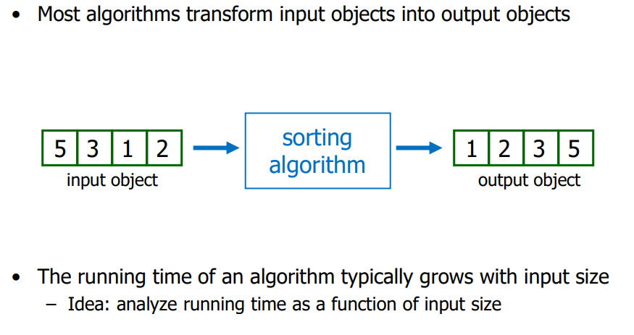
Calculate Running time

Slide 7
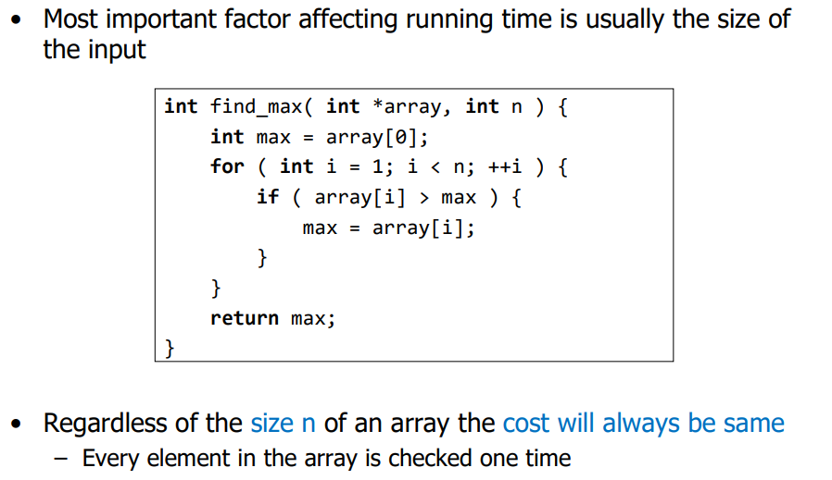
Calculate running time

Slide 8
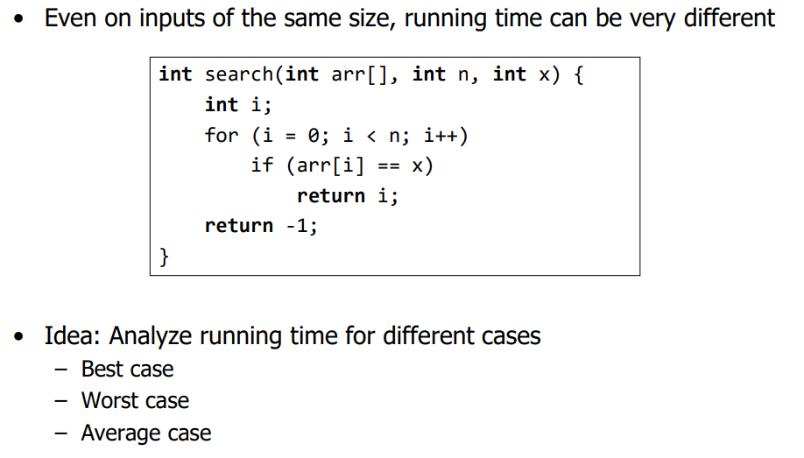
Calculate Running time

Slide 9
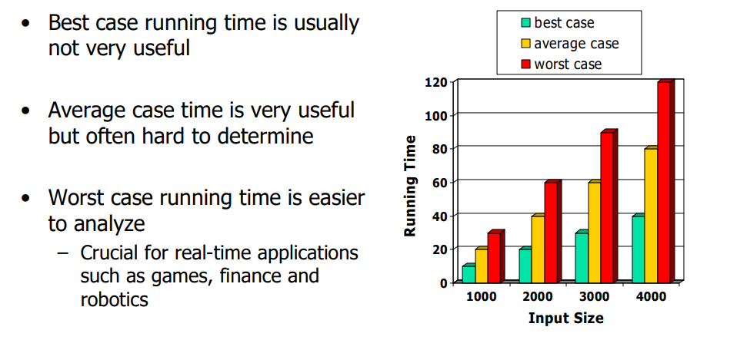
Calculate Running time

Slide 10
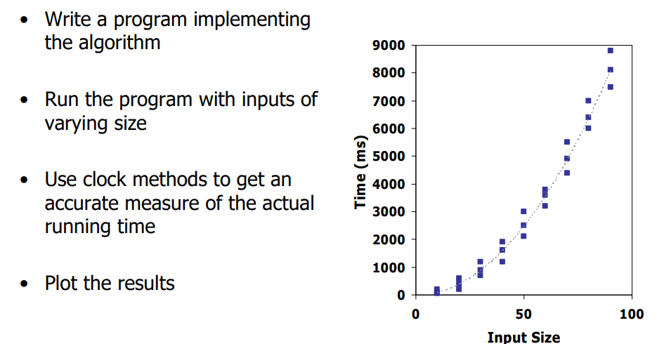
Experiment Evaluation of Running time

Slide 11
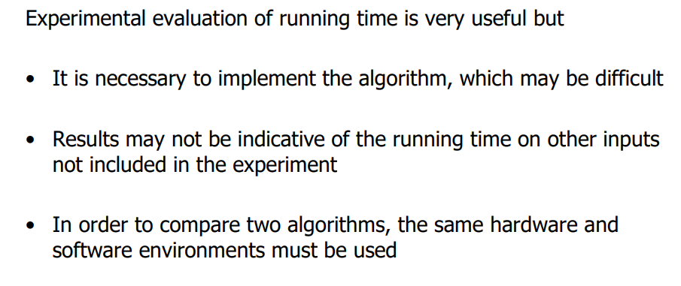
Limitations of experiment

Slide 12
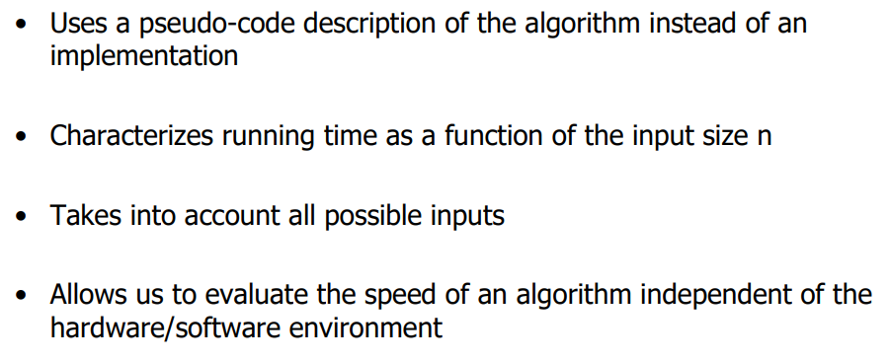
Theoretical Analysis of Running Time

Slide 13
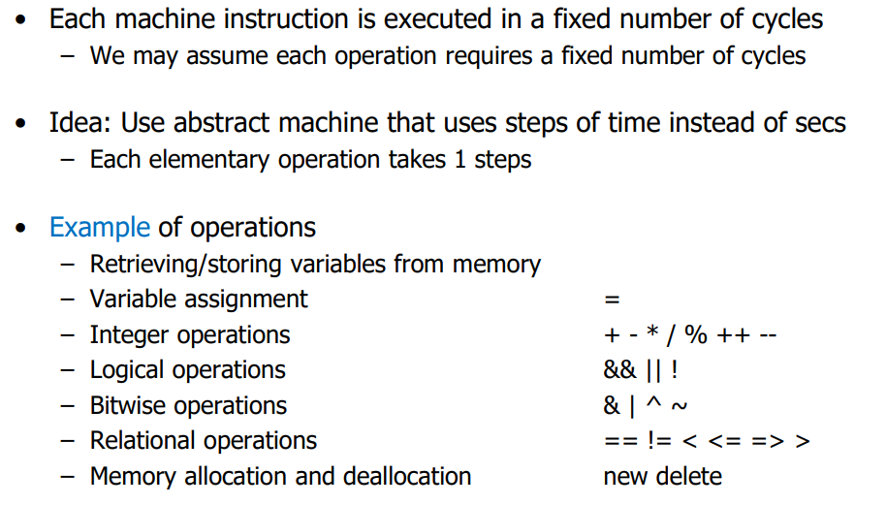
Analyzing an Algorithm-Operations

Slide 14
Simple Example (1)
// Input: int A[N], array of N integers
// Output: Sum of all numbers in array A
int Sum(int A[], int N)
{
int s=0;
for (int i=0; i< N; i++)
s = s + A[i];
return s;
}
How should we analyse this?

Slide 15
Simple Example (2)
// Input: int A[N], array of N integers
// Output: Sum of all numbers in array A
int Sum(int A[], int N){
int s=0;
for (int i=0; i< N; i++)
s = s + A[i];
return s;
}
1
2
3
4
5
1,2,8: Once
3,4,5,6,7: Once per each iteration
of for loop, N iteration
Total: 5N + 3
The complexity function of the
algorithm is : f(N) = 5N +3
6
7
8

Slide 16
Simple Example (3) Growth of 5n+3
Estimated running time for different values of N:
N = 10 => 53 steps
N = 100 => 503 steps
N = 1,000 => 5003 steps
N = 1,000,000 => 5,000,003 steps
As N grows, the number of steps grow in linear proportion to N for this function “Sum”

Slide 17
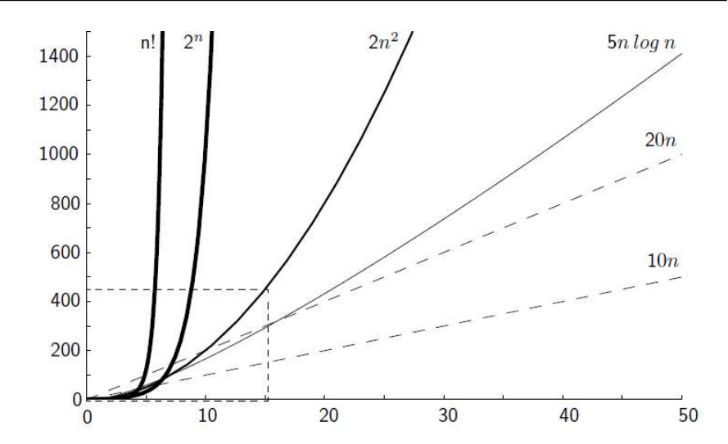
Growth Rate

Slide 18
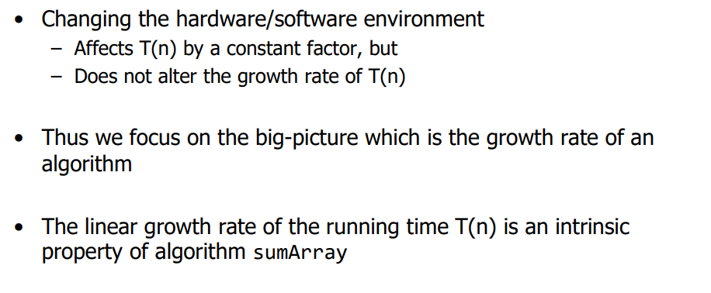
Growth rate

Slide 19
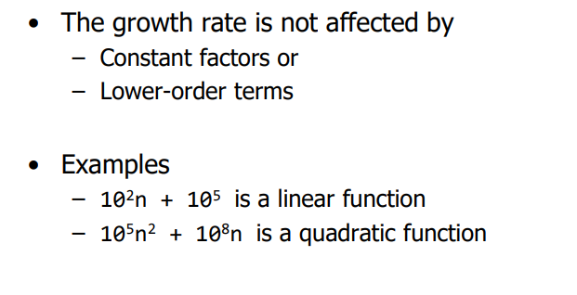
Constant Factors

Slide 20
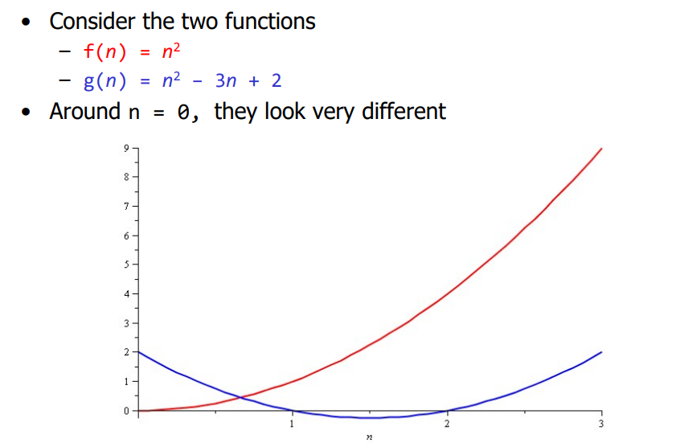
Growth Rate- Example

Slide 21
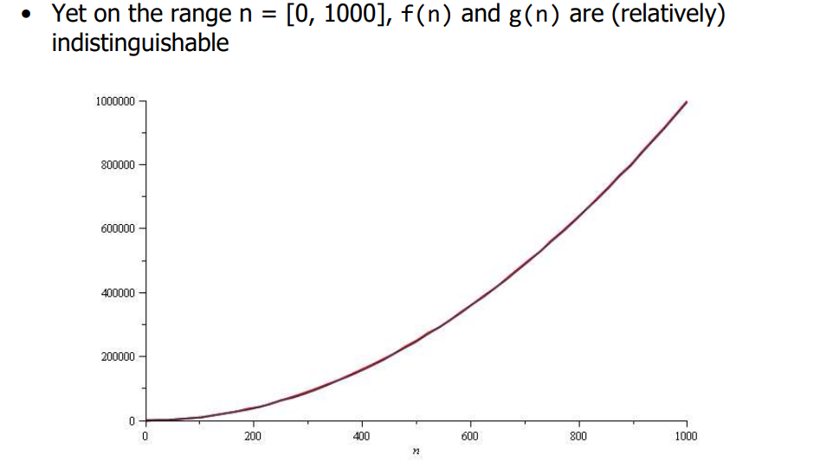
Growth rate Example

Slide 22
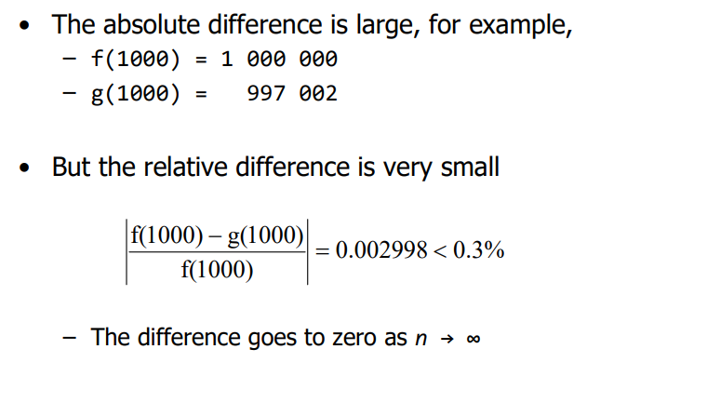
Growth Rate-Example

Slide 23
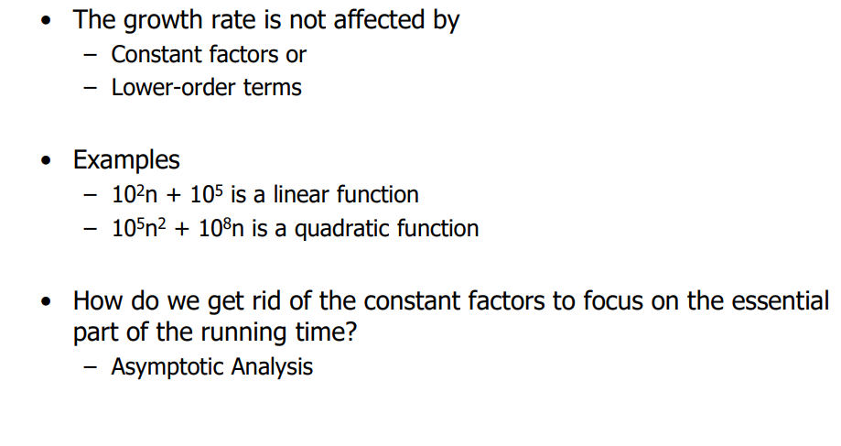
Constant Factors

Slide 24
Simple Example (2)
// Input: int A[N], array of N integers
// Output: Sum of all numbers in array A
int Sum(int A[], int N){
int s=0;
for (int i=0; i< N; i++)
s = s + A[i];
return s;
}
1
2
3
4
5
1,2,8: Once
3,4,5,6,7: Once per each iteration
of for loop, N iteration
Total: 5N + 3
The complexity function of the
algorithm is : f(N) = 5N +3
6
7
8

Slide 25
What Dominates in Previous Example?
What about the +3 and 5 in 5N+3?
As N gets large, the +3 becomes insignificant
5 is inaccurate, as different operations require varying amounts of time and also does not have any significant importance
What is fundamental is that the time is linear in N.
Asymptotic Complexity: As N gets large, concentrate on the
highest order term:
Drop lower order terms such as +3
Drop the constant coefficient of the highest order term i.e. N

Slide 26
Asymptotic Complexity
The 5N+3 time bound is said to "grow asymptotically" like N
This gives us an approximation of the complexity of the algorithm
Ignores lots of (machine dependent) details, concentrate on the bigger picture

Slide 27
COMPARING FUNCTIONS: ASYMPTOTIC NOTATION
Big Oh Notation: Upper bound
Omega Notation: Lower bound
Theta Notation: Tighter bound

Slide 28
Big Oh Notation [1]
If f(N) and g(N) are two complexity functions, we say
f(N) = O(g(N))
(read "f(N) is order g(N)", or "f(N) is big-O of g(N)")
if there are constants c such that for N > c,
f(N) ≤ c * g(N)
for all sufficiently large N.

Slide 29
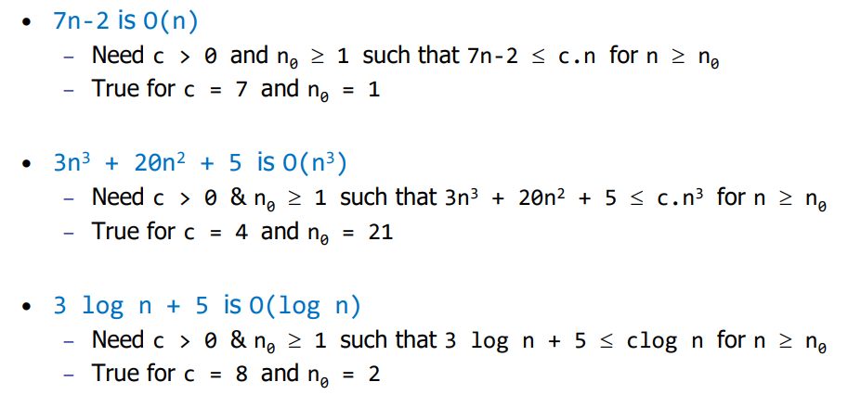
Big-Oh Notation -Example

Slide 30
Example (2): Comparing Functions
Which function is better?
10 n² Vs n³

Slide 31
Comparing Functions
As inputs get larger, any algorithm of a smaller order will be more efficient than an algorithm of a larger order
0.05 N² = O(N²)
3N = O(N)
Time (steps)
N = 60
Input (size)

Slide 32
Big-Oh Notation
Even though it is correct to say “7n - 3 is O(n³)”, a better statement is “7n - 3 is O(n)”, that is, one should make the approximation as tight as possible
Simple Rule:
Drop lower order terms and constant factors
7n-3 is O(n)
8n²log n + 5n² + n is O(n²log n)

Slide 33
Which Notation do we use?
To express the efficiency of our algorithms which of the three notations should we use?
As computer scientist we generally like to express our algorithms as big O since we would like to know the upper bounds of our algorithms.
Why?
If we know the worse case then we can aim to improve it and/or avoid it.

Slide 34
Performance Classification
f(n) | Classification
1 | Constant: run time is fixed, and does not depend upon n. Most instructions are executed once, or only a few times, regardless of the amount of information being processed
log n | Logarithmic: when n increases, so does run time, but much slower. Common in programs which solve large problems by transforming them into smaller problems. Exp : binary Search
n | Linear: run time varies directly with n. Typically, a small amount of processing is done on each element. Exp: Linear Search
n log n | When n doubles, run time slightly more than doubles. Common in programs which break a problem down into smaller sub-problems, solves them independently, then combines solutions. Exp: Merge
n² | Quadratic: when n doubles, runtime increases fourfold. Practical only for small problems; typically the program processes all pairs of input (e.g. in a double nested loop). Exp: Insertion Search
n³ | Cubic: when n doubles, runtime increases eightfold. Exp: Matrix
2^{n} | Exponential: when n doubles, run time squares. This is often the result of a natural, “brute force” solution. Exp: Brute Force.

Slide 35
Standard Analysis Techniques
Constant time statements
Analyzing Loops
Analyzing Nested Loops
Analyzing Sequence of Statements
Analyzing Conditional Statements

Slide 36
Constant time statements
Simplest case: O(1) time statements
Assignment statements of simple data types int x = y;
Arithmetic operations: x = 5 * y + 4 - z;
Array referencing: A[j] = 5;
Array assignment: ∀ j, A[j] = 5;
Most conditional tests: if (x < 12) ...

Slide 37
Analyzing Loops[1]
Any loop has two parts:
How many iterations are performed?
How many steps per iteration?
int sum = 0,j;
for (j=0; j < N; j++)
sum = sum +j;
Loop executes N times (0..N-1)
4 = O(1) steps per iteration
Total time is N * O(1) = O(N*1) = O(N)

Slide 38
Analyzing Loops[2]
What about this for loop?
int sum =0, j;
for (j=0; j < 100; j++)
sum = sum +j;
Loop executes 100 times
4 = O(1) steps per iteration
Total time is 100 * O(1) = O(100 * 1) = O(100) = O(1)

Slide 39
Analyzing Nested Loops[1]
Treat just like a single loop and evaluate each level of nesting as needed:
int j,k;
for (j=0; j<N; j++)
for (k=N; k>0; k--)
sum += k+j;
Start with outer loop:
How many iterations? N
How much time per iteration? Need to evaluate inner loop
Inner loop uses O(N) time
Total time is N * O(N) = O(N*N) = O(N²)

Slide 40
Sequence of Statements
For a sequence of statements, compute their complexity functions individually and add them up
Total cost is O(n²) + O(n) +O(1) = O(n²)

Slide 41
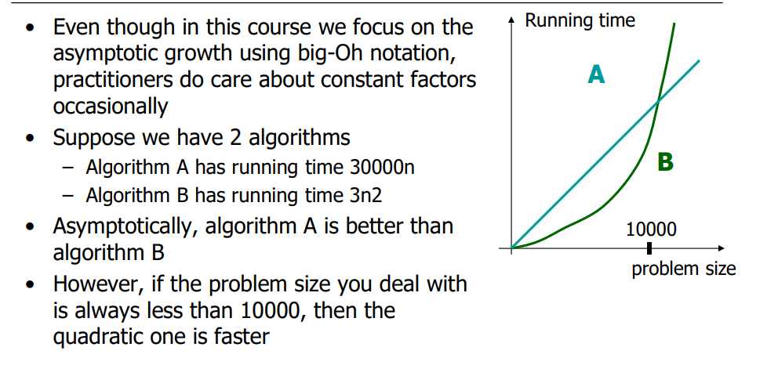
Final Notes

Slide 42
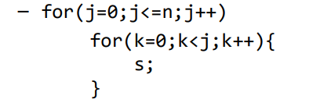
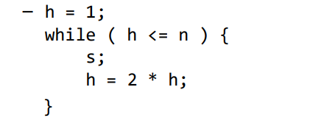
Practice Example

